Slide 1

Tier-II Funding
Town Hall
May 27, 2026

Slide 2
Tier-II Funding Town Hall May 2026
Agenda
Introduction to Tier-II Funding
Eligibility
Workflow
General Policies
Category-Specific Policies
Questions
Contact Us

Slide 3

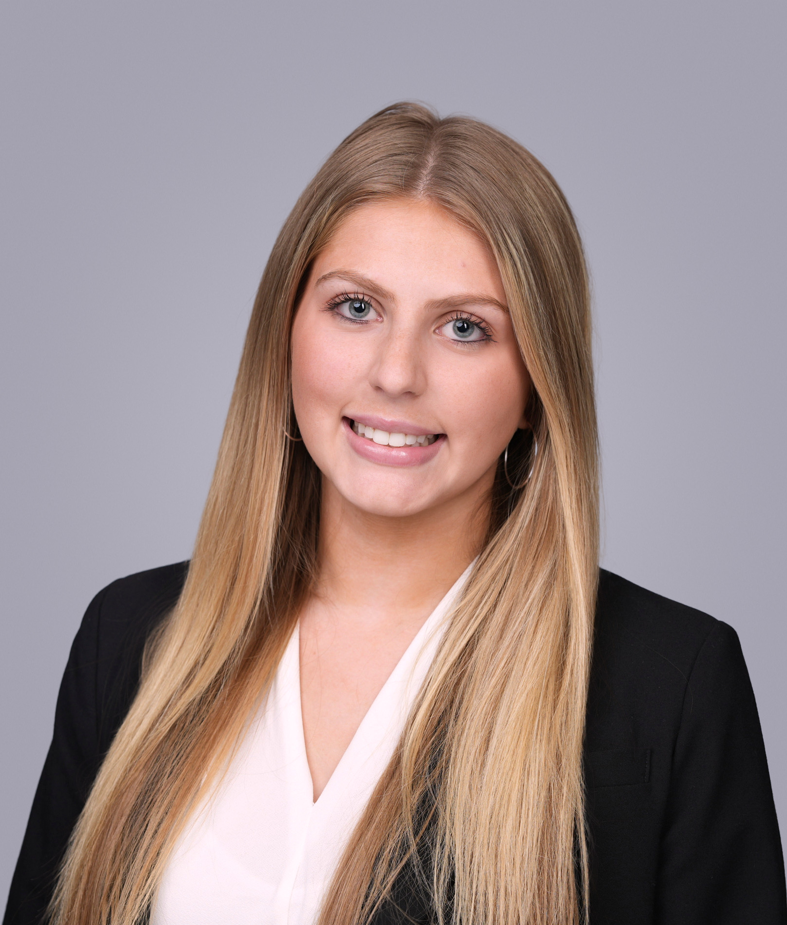
Tier-II Funding Town Hall May 2026
Quick Introductions!
Abby Cummings
Tier-II Funding Director
Contact: fundingdirector@usg.uconn.edu
Jackie Larraz
Deputy Funding Director
Contact: fundingassistant@usg.uconn.edu

Slide 4
Tier-II Funding Town Hall May 2026
What is USG Funding?
What USG Funding?
  Utilizes an allocated portion of our USG budget to enrich the experiences of Active Tier II Organizations
Our Team- Executive branch
  Tier-II Funding Director
  Tier-II Deputy Funding Director
  9 Funding Staff Members
  USG Comptroller (exemptions)
$2M+
$1M+
Yearly Budget
Average allocated for Tier-II organizations
Notes:
What is USG?
USG exists to enrich the lives of UConn's undergraduate student body and help student groups reach their fullest potential. We operate across three branches — Legislative, Executive, and Judicial. On the financial side, the key people you'll interact with are the Comptroller, the Funding Director, and the Funding Staff.
To give you a sense of scale: USG manages a yearly budget of over two million dollars, and a little over one million of that is allocated specifically to Tier-II registered student organizations.

Slide 5
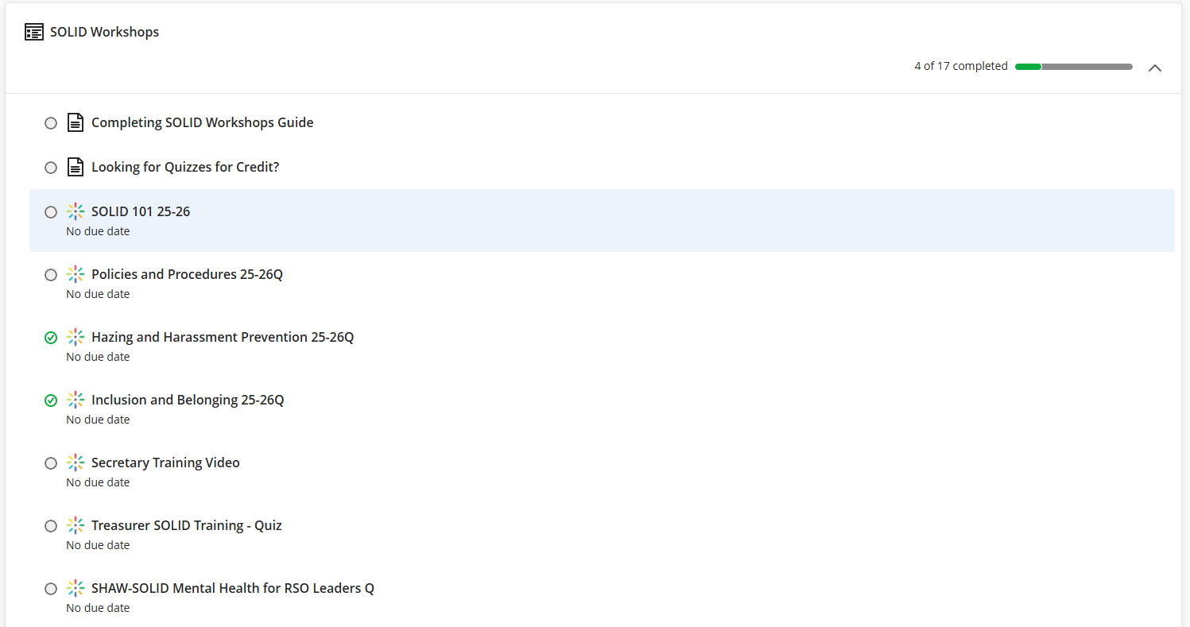
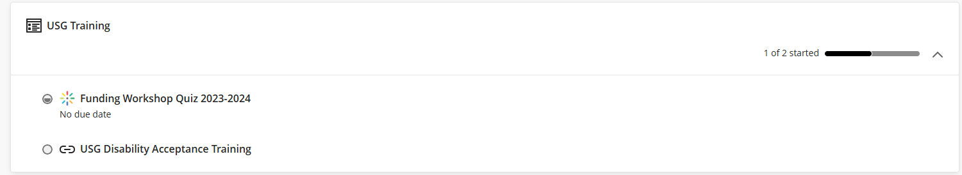
How can your RSO receive funding from USG?
Tier-II Funding Town Hall May 2026
USG Funding Eligibility
Active Status per SOLID
All SOLID training on HuskyCT must be completed
  SOLID 101, values training, treasurer training, policies training, hazing training, inclusion training
  Listed on UConntact
Registered as a Tier-II
Only Tier-II RSO’s are eligible for USG funding
USG Funding Quiz
USG Funding Quiz must be completed with 85%+ score
Notes:
Before you can receive any funding, your RSO must meet three requirements — and all three must be satisfied before we'll consider your request.
First, your organization needs Active Status per SOLID. That means completing all required training on HuskyCT: SOLID 101, values training, treasurer training, policies training, hazing training, and inclusion training. You also need to be listed on UConntact.
Second, you must be registered as a Tier-II RSO. Only Tier-II organizations are eligible for USG funding. If you're unsure of your status, you can check this on the SOLID website.
Third, you need to complete the USG Funding Quiz with a score of 85% or higher.

Slide 6
01
02
03
04
05
06
05
06
USG Funding Town Hall May 2026
General Request Workflow
What does the USG funding process look like?
Initial submission
Initial review - Funding Staff
FA 1 - Trustee Org Staff
Funding Vote - Funding Staff
Fiscal Officer - Trustee Org Staff
Pre-Purchase - RSO
Post-Purchase - RSO
Final Bookkeeping
Notes:
Let's walk through what the funding process looks like from start to finish.
Your RSO submits an initial funding request through the Kuali Build platform.
The Funding Staff conducts an initial review for policy compliance.
This is where your request may be sent to you to correct any errors or for clarification. Please make sure to check your email for any send backs, as you only have two business days to make corrections.
The request moves to our Professional Staff for FA 1.
The Funding Staff votes. We typically vote on requests once weekly.
If approved, the professional staff handles the financial processing and purchasing.
Your RSO completes the pre-purchase step. Note that this must be completed at least two weeks prior to your event/when the funds are needed.
After that, your RSO submits post-purchase documentation, and professional staff completes final bookkeeping. Your organization plays an active role at multiple stages, so stay on top of your emails and deadlines throughout this process.

Slide 7
Tier-II Funding Town Hall May 2026
General Policies
01
$15,000 annual cap
RSO’s can be funded up to $15,000 per academic year
Payments to Vendors
We will pay the vendor in your place! (No reimbursements)
*Note: exception for approved travel categories ONLY
02
Academic Sessions
Funding can only be used during academic semesters, not including spring or Thanksgiving break
03
Benefit
Tier-II funding can only be used to benefit undergraduate, fee-paying Storrs students
Notes:
What is USG?
USG exists to enrich the lives of UConn's undergraduate student body and help student groups reach their fullest potential. We operate across three branches — Legislative, Executive, and Judicial. On the financial side, the key people you'll interact with are the Comptroller, the Funding Director, and the Funding Staff.
To give you a sense of scale: USG manages a yearly budget of over two million dollars, and a little over one million of that is allocated specifically to Tier-II registered student organizations.

Slide 8
Specific Funding Categories
(and required documentation)
Tier-II Funding Town Hall May 2026
Admission/Registration/Dues
Bus Rental
Catering
Coaching
Contractual Services
Car Rental
Equipment/supplies
Printing
Rental
Travel Reimbursement

Slide 9
Tier-II Funding Town Hall May 2026
Admission/Registration/Dues
Required Documentation
Initial submission:
SOLID Roster must
  Be up to date (FY 26-27)
Proof of event
  Includes date, time, and location of event
Price quote must
  Show price per person/team
  Come directly from the vendor
Payment due date must
  Come directly from vendor
List of attendees must
  List all attendees as on SOLID roster (no nicknames)
Pre-Purchase:
Proof of acceptance
Deadlines
Initial submission → 6 weeks before event/payment deadline (whichever comes first)
Pre-Purchase → 2 weeks before event/payment deadline
Specific Policies
Must benefit the entire RSO, not individual(s)
Cannot continue/transfer after graduation or withdrawal from UConn

Slide 10
Tier-II Funding Town Hall May 2026
II. Bus Rental
Deadlines
Initial submission → 6 weeks before event/payment deadline (whichever comes first)
Pre-Purchase → 2 weeks before event/payment deadline
Post-Purchase → 4 weeks after event
Required Documentation
Initial submission:
SOLID Roster must
  Be up to date (FY 26-27)
Proof of event (if related to event)
  If hosting, link UConntact page
Price quote must
  Come directly from the vendor (DATTCO recommended)
Linked OCAA Form must
  Align with the event in which funding has been requested for
Specific Policies
Does not fall into $9,999.99 travel cap
Up to 6 attendees for conferences, and 16 attendees for competitions/tournaments

Slide 11
Tier-II Funding Town Hall May 2026
III. Catering
Deadlines
Initial submission → 6 weeks before event/payment deadline (whichever comes first)
Pre-Purchase → 2 weeks before event/payment deadline
Post-Purchase → 4 weeks after event
Required Documentation
Initial submission:
SOLID Roster must
  Be up to date (FY 26-27)
Proof of Event (must relate to event)
UConntact page (if hosting)
Right of refusal form (if on-campus)
Pre-Purchase:
RSVP List
Post-Purchase:
Final attendance list
Specific Policies
Catering is not permitted for General Body Meetings
Must align with local food per diem rates (GSA.gov)
Only permitted for events that are on-campus or within a five-mile radius of campus
  Not permitted in academic classrooms

Slide 12
Tier-II Funding Town Hall May 2026
IV. Coaching
Deadlines
Initial submission → 6 weeks before start date
If over $2500 → 7 weeks before start date
Pre-Purchase → 2 weeks before start date
Invoicing → 4 weeks after end date
Required Documentation
Initial submission:
SOLID Roster must
  Be up to date (FY 26-27)
Price quote must
  Utilize the Intent to Coach form
Coach Resume
Practice/Tournament Schedule
Invoicing:
Proof of event
  For practices → reservation information
  For tournaments → proof of qualification/participation
Specific Policies
$9,999.99 annual cap
$40 hourly cap
Can now be approved tentatively
Coaches cannot be current UConn students

Slide 13
Tier-II Funding Town Hall May 2026
V. Contractual Services (other than coaching)
Deadlines
Initial submission → 6 weeks before event
If over $2500 → 7 weeks before event
Pre-Purchase → 2 weeks before event
Post-Purchase Verification → 4 weeks after event
Required Documentation
Initial submission:
SOLID Roster must
  Be up to date (FY 26-27)
Price quote must
  Come directly from the vendor
  Utilize an hourly rate
Contractor Resume
Proof of event (if related to event)
  If hosting, link UConntact page
Specific Policies
$300 per hour cap (per event) for one-time instruction, event staff (dancers, singers, djs, etc.)
$450 per hour cap (per event) for speakers
$40 per hour cap for repeated instruction
Contractors cannot be current UConn students

Slide 14
Tier-II Funding Town Hall May 2026
VI. Car Rental
Deadlines
Initial submission → 6 weeks before event
Pre-Purchase → 2 weeks before event
Post-Purchase Verification → 4 weeks after event
Required Documentation
Initial submission:
SOLID Roster must
  Be up to date (FY 26-27)
Proof of event (if related to event)
  If hosting, link UConntact page
Price quote
  Enterprise recommended
Driver/passenger list
  Drivers must be 21+ at time of travel
  Passengers must be listed on SOLID roster
Linked OCAA Form must
  Align with the event/meetings in which funding has been requested for
Specific Policies
Does not fall into $9,999.99 travel cap
Up to 6 attendees for conferences, and 16 attendees for competitions/tournaments
Add-on expenses, including refueling and mileage, will not be funded by USG

Slide 15
Tier-II Funding Town Hall May 2026
VII. Equipment/supplies
Deadlines
Initial submission → 6 weeks before event
Pre-Purchase → 2 weeks before event
Post-Purchase Verification → 4 weeks after event
Required Documentation
Initial submission:
SOLID Roster must
  Be up to date (FY 26-27)
Proof of event (if related to event)
  If hosting, link UConntact page
  If off campus, link OCAA form
Price quote must
  Come directly from Vendor
    Amazon, Walmart, etc- screenshot is okay
  Show price per item, shipping and subtotal
UConn Logo Usage approval
  If item is customized with UConn logo
Specific Policies
Equipment → Useful life of over a year
  Subject to inventory management requirements
Supplies → Useful life of less than a year
Certain items require specific vendors
EHS Restricted Equipment List requires EHS approval

Slide 16
Tier-II Funding Town Hall May 2026
VIII. Printing
Deadlines
Initial submission → 6 weeks before event
Pre-Purchase → 2 weeks before event
Post-Purchase Verification → 4 weeks after purchase
Required Documentation
Initial submission:
SOLID Roster must
  Be up to date (FY 26-27)
Proof of event (if related to event)
  If hosting, link UConntact page
Price quote must
  Come directly from Vendor
    UConn Document Production Center recommended
  Show price per page/copy and subtotal
UConn Logo Usage approval
  If printing is customized with UConn logo
Specific Policies
USG OSS offers 200 pages of free printing per week
  Funding can be used when more pages or a specific type of paper/format is required

Slide 17
Tier-II Funding Town Hall May 2026
IX. Rental (other than bus & car)
Deadlines
Initial submission → 6 weeks before event
Pre-Purchase → 2 weeks before event
Post-Purchase Verification → 4 weeks after purchase
Required Documentation
Initial submission:
SOLID Roster must
  Be up to date (FY 26-27)
Price quote must
  Come directly from Vendor
Practice/Meeting schedule
  If related to recurring practices/meetings
Proof of event (if related to event)
  If hosting, link UConntact page
Specific Policies
Damage done to any rented space/equipment is the responsibility of your RSO
Rentals, like equipment/supplies, require approval from EHS if they are on the Restricted Equipment list

Slide 18
Tier-II Funding Town Hall May 2026
X. Travel Reimbursements (mileage, airfare, hotel, lodging)
Deadlines
Initial submission → 5 weeks before travel
Pre-Purchase → 2 weeks before travel
Post-Travel Verification → 2 weeks after travel
Required Documentation
Initial submission:
SOLID Roster must
  Be up to date (FY 26-27)
Per diem rates (hotel/lodging)
Google map (mileage)
  Start point: University of Connecticut
  Round-trip
List of attendees must
  List all attendees as on SOLID roster (no nicknames)
Linked OCAA Form must
  Align with the event in which funding has been requested for
Specific Policies
$9,999.99 travel cap
  Hotel/lodging → GSA per diem rate
  Mileage → IRS Standard Business Mileage Rate
  Airfare → $300 per ticket
Up to 6 attendees for conferences, and 16 attendees for competitions/tournaments

Slide 19
Tier-II Funding Town Hall May 2026
X. Travel Reimbursements (continued)
Reimbursement Structure
The RSO pays for travel expenses out of pocket, and is then reimbursed AFTER post-travel verification
Under the condition that all required documentation is provided and verified by our staff
If the RSO ends up paying more than what was initially approved, USG will reimburse up to the approved amount
Incidental expenses (baggage, wifi, upgrades, etc.) will not be reimbursed under any circumstances
Required Documentation
All categories:
Final list of attendees
  List all attendees as on SOLID roster (no nicknames)
Mileage:
Google maps screenshot
Final driver/passenger list
Proof of attendance
  Reservation confirmations, admission receipts, hotel receipts, etc.
Other Categories:
Receipt with last 4 digits of card used
  If not provided, please submit bank statement with name of payee
Credit card with all information except last 4 digits and payee name redacted

Slide 20
Questions?
Tier-II Funding Town Hall May 2026

Slide 21
Tier-II Funding Town Hall May 2026
Contact Us
Jackie Larraz
Deputy Funding Director
Contact: fundingassistant@usg.uconn.edu
Abby Cummings
Tier-II Funding Director
Contact: fundingdirector@usg.uconn.edu
General Inquiries:
bookkeeping@usg.uconn.edu

